Slide 1


GE Medical Systems Ltd
UK Gender Pay Gap Report 2024
About GE HealthCare
GE HealthCare is a trusted partner and leading global healthcare solutions provider, innovating medical technology, pharmaceutical diagnostics, and integrated, cloud-first AI-enabled solutions, services and data analytics. We aim to make hospitals and health systems more efficient, clinicians more effective, therapies more precise, and patients healthier and happier. Serving patients and providers for more than 125 years, GE HealthCare is advancing personalized, connected and compassionate care, while simplifying the patient’s journey across care pathways.
Together, our Imaging, Advanced Visualization Solutions, Patient Care Solutions and Pharmaceutical Diagnostics businesses help improve patient care from screening and diagnosis to therapy and monitoring. We are a $19.7 billion business with approximately 53,000 colleagues working to create a world where healthcare has no limits.
GE HealthCare employs around 1200 people in the UK across all disciplines, with a primary focus on Sales and Services.
This Report concerns our GE Medical Systems Limited entity which includes over 650 employees
I confirm that the information contained within this report is accurate.
Simon McGuire
Director GE Medical Systems Ltd
© 2025 GE HealthCare. GE is a trademark of General Electric Company used under trademark license.

Slide 2
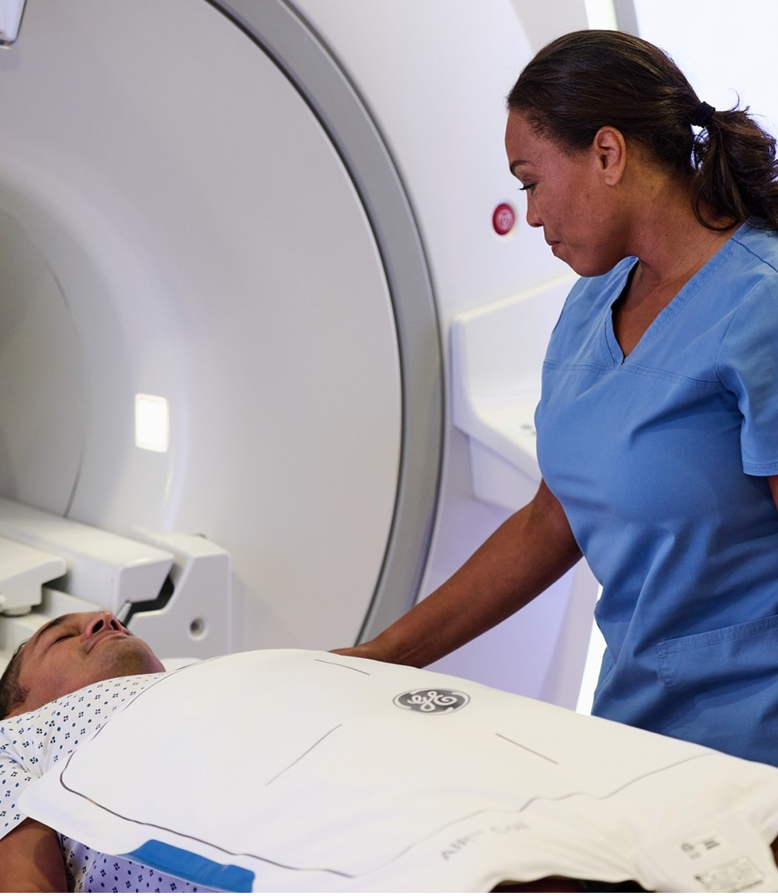
GE Medical Systems Ltd Pay Gap
The Gender Pay Gap results show both mean and median calculations favouring males. This entity largely includes our sales and services populations. Whilst we see a relatively strong balance of male and female colleagues in the lowest pay quartile, there is a clear imbalance in the other quartiles. This is driven by a high representation of male employees in STEM related technical roles which are field based. It has historically been challenging to attract females into these types of positions due to the general underrepresentation of females with STEM skill sets and the demands of work-based travel. We continue to target and work towards achieving a greater balance on both pay and representation.
GE HealthCare regularly reviews its approach to pay equity and is confident that it offers equal pay between our male and female populations undertaking comparable work.
    Male colleagues earn 7.46% more MEAN pay than female colleagues
Male colleagues earn 7.28% more
MEDIAN pay than female colleagues
© 2025 GE HealthCare. GE is a trademark of General Electric Company used under trademark license.

Slide 3
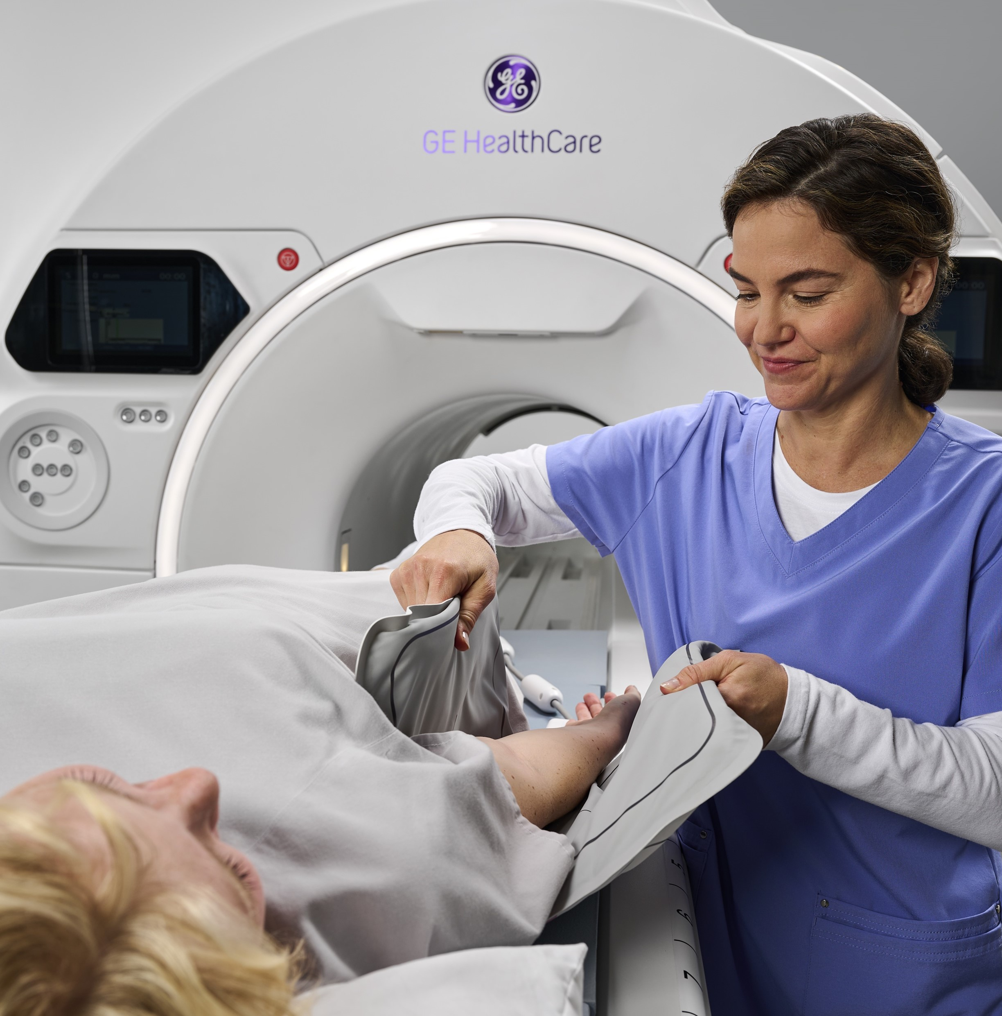
Quartile A
Lower Paid
Comms should we change photo
GE Medical Systems Ltd
Gender Breakdown
Pay Per Quartile
Quartile B
Lower Middle
24%
41%
59%
76%
Quartile C
Upper Middle
Quartile D
Upper Paid
24%
29%
76%
71%
© 2025 GE HealthCare. GE is a trademark of General Electric Company used under trademark license.

Slide 4


GE Medical Systems Ltd Bonus Gap
Most of our colleagues (male and female) receive a bonus in some form. Our bonuses cover a wide range of reward types, and this, along with changes in gender distribution through our organisation (an increase of female in quartile B & D, and more males in quartile A compared with last year) may be why we see a noticeable difference between the mean and the median data with the mean favouring males and the median favouring females. It is difficult to draw clear inferences from these figures and we continue to see variation year on year.
    Male colleagues earn 8.16% more MEAN bonus than female colleagues
91.20% of female colleagues
received a bonus
Female colleagues earn 42.06% more
MEDIAN bonus than male colleagues
92.06% of male colleagues
received a bonus

Slide 5




GE HealthCare Diversity Initiatives
GE HealthCare continues to focus on ways to drive greater female representation, in particular in STEM (science, technology, engineering and mathematics) disciplines both in its own business and more broadly.
In 2024, GE HealthCare again sponsored the Girls into Engineering course, run by the Smallpeice Trust. Also, our homegrown GirlsGetSET inspiration programme is specifically aimed at 12-13 year old girls curious about STEM. This year 450 girls have already received their Bronze Industrial Cadets Accreditation.
117
Active GE HealthCare UK Volunteers
57
Schools
1000+
GirlsGetSET Participants
7629
Students Reached
From GE HealthCare UK Volunteering January to November 2024 data
© 2025 GE HealthCare. GE is a trademark of General Electric Company used under trademark license.

